Slide 1
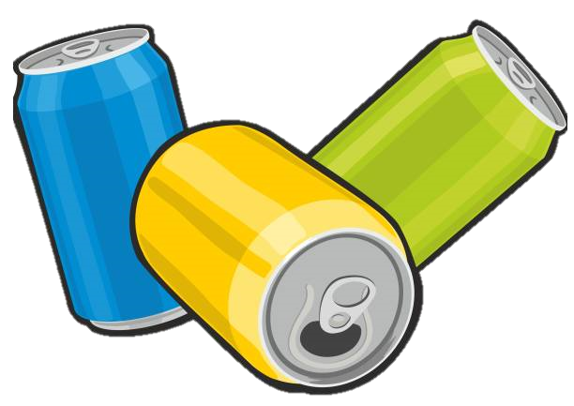
Codex
Insights to the Marketing Team in Food & Beverage Industry

Slide 2
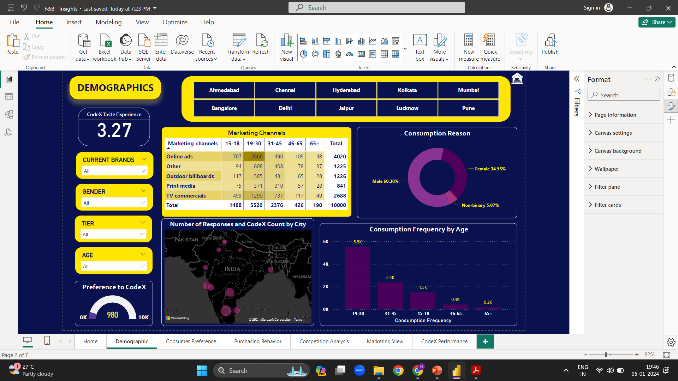
DEMOGRAPHIC INSIGHTS
Which type of marketing reaches the most Youth (15-30)?
Who prefers energy drink more? (male/female/non-binary?)
Which age group prefers energy drinks more?
Online Ads are the most effective channel that reached 3373 respondents Age group 15-30.
Out of 10 thousand respondents, the number of male respondents is 6038.
This shows 60% of the consumers are male who prefer energy drinks more.
From the result of this survey, we get to know that energy drinks are more popular among youngsters. More than 50% of the respondents belong to the Age Group 19-30.
If we look at overall young age groups from 15 to 30, then the % will rise to 70%.

Slide 3
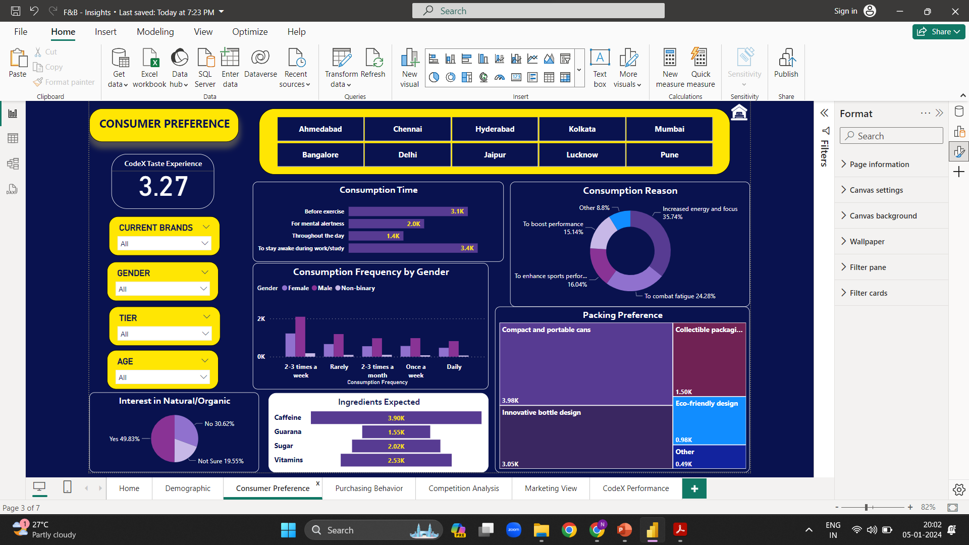
CONSUMER PREFERENCES
What are the preferred ingredients of energy drinks among respondents?
What packaging preferences do respondents have for energy drinks?
As we know caffeine increases attention and alertness, and it is often used in energy drinks. Caffeine is the most expected ingredient followed by the Vitamins in energy drinks.
Compact & Portable Cans are high in demand followed by Innovative Bottle Designs.

Slide 4
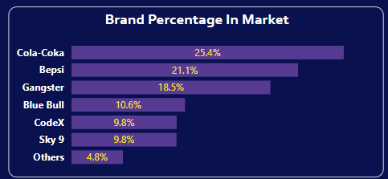
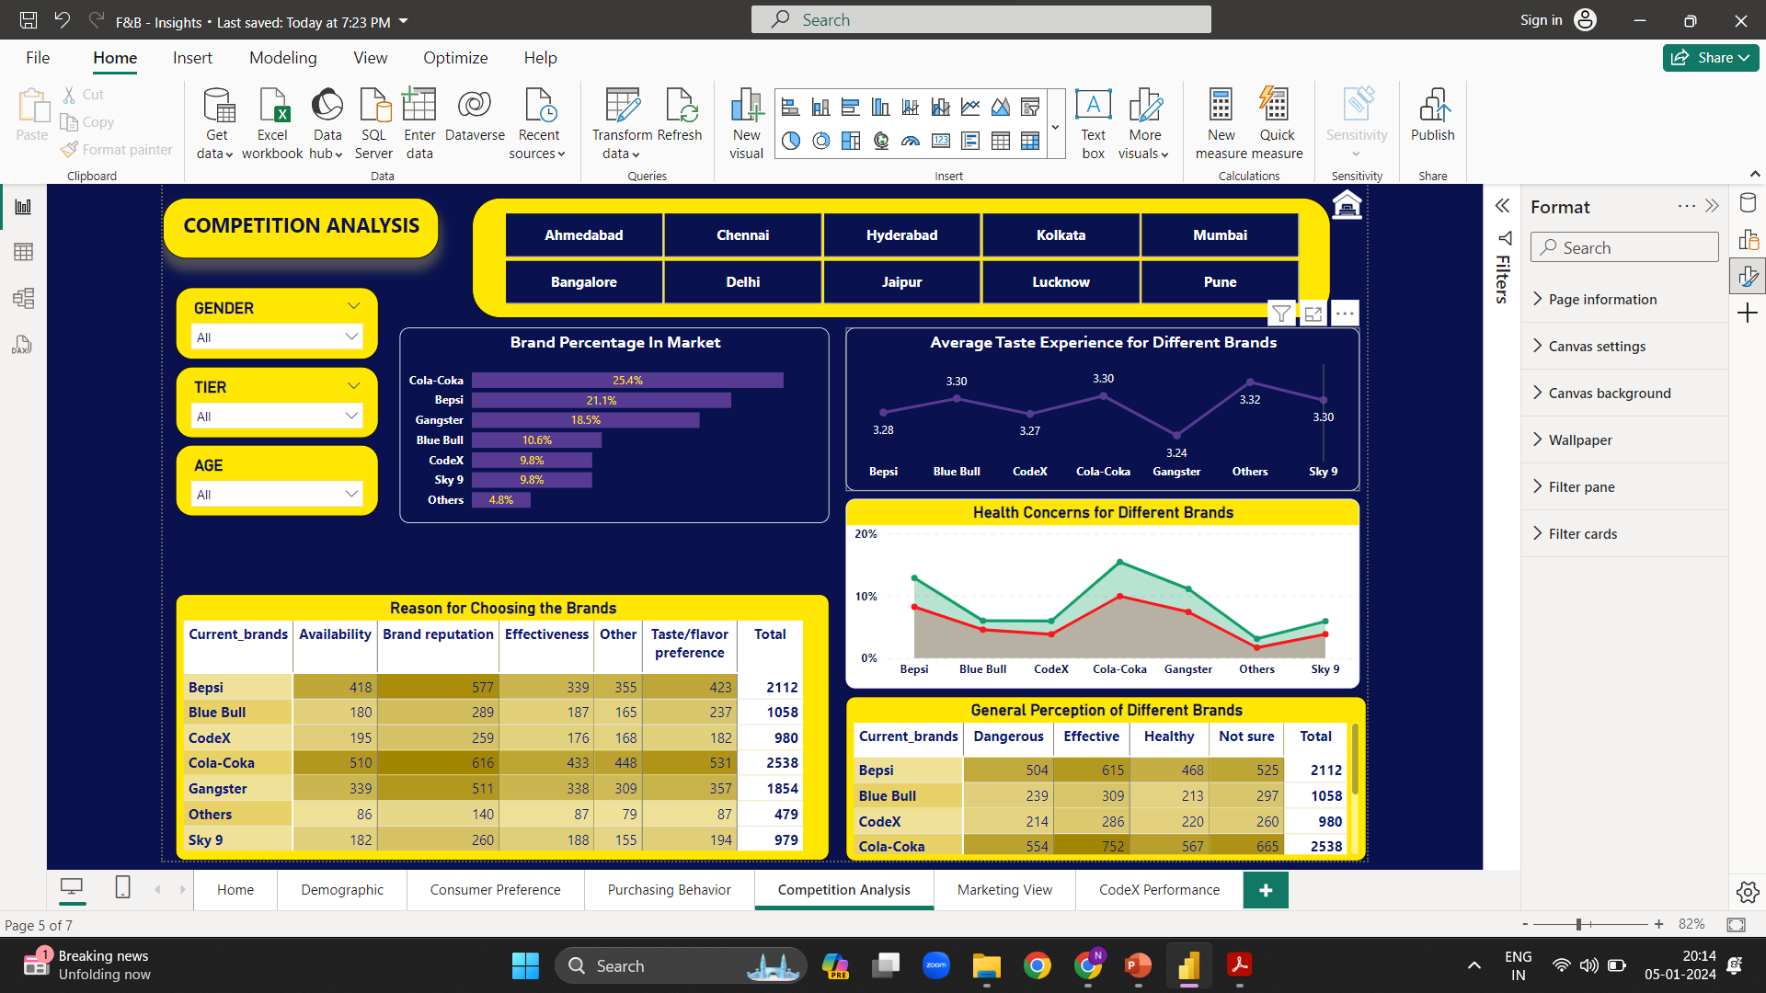
COMPETITION ANALYSIS
Who are the current market leaders?
What are the primary reasons consumers preferring those brands over ours?
Cola Coka is leading the market followed by Bepsi. The data shows there more respondents for Cola Coka than the other brands.
The top reason for choosing the brands by consumers is brand reputation.

Slide 5
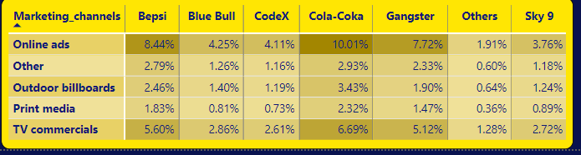
MARKETING CHANNELS
Which marketing channel can be used to reach more customers and how effective it is from other?
As we have seen previously Online Ads are the most effective way to reach maximum audiences in a short duration & it is cost effective as well.

Slide 6
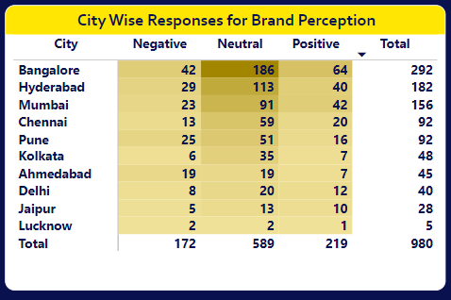

BRAND PENETRATION
What do people think about our brand? (overall rating)
Which cities do we need to focus more on?
People who has tasted CodeX has given a average rating of 3.27
Cities like Bangalore, Hyderabad, Mumbai, Chennai and Pune has the highest Neutral responses. Hence focusing more on these cities will fetch us more positive responses.

Slide 7
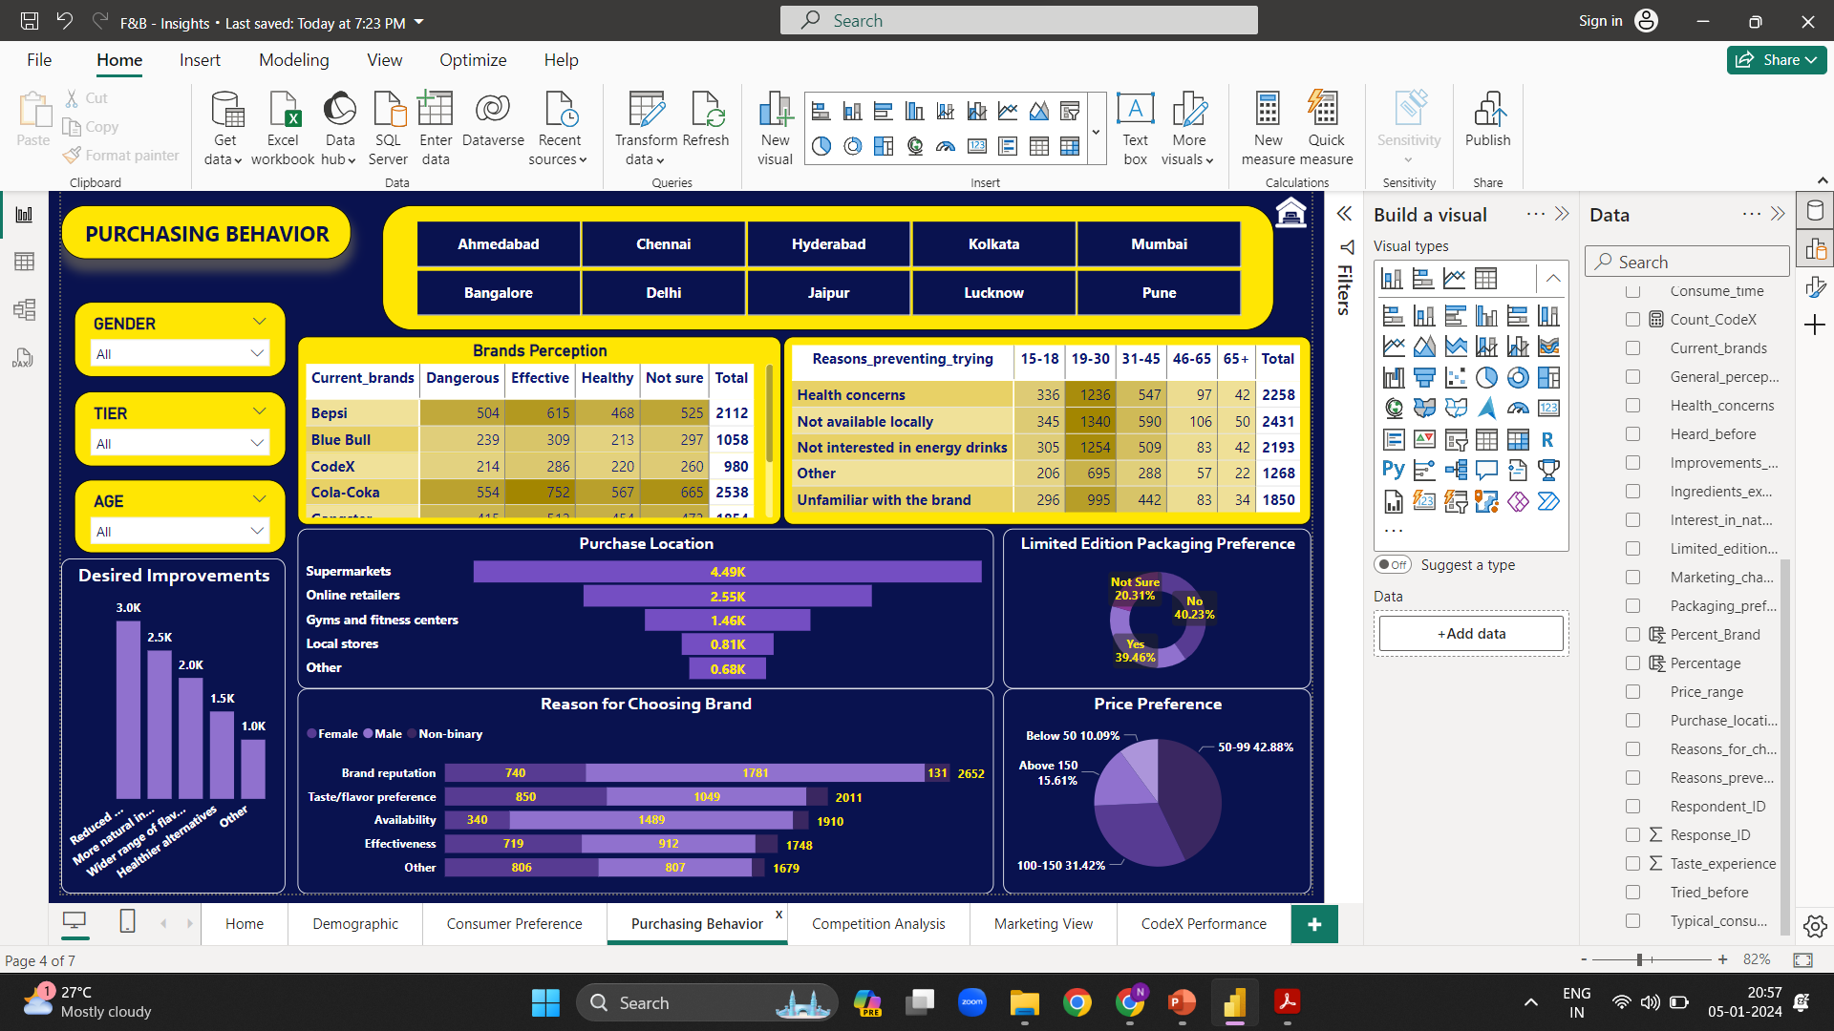
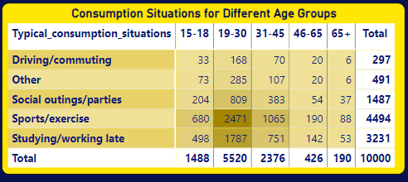
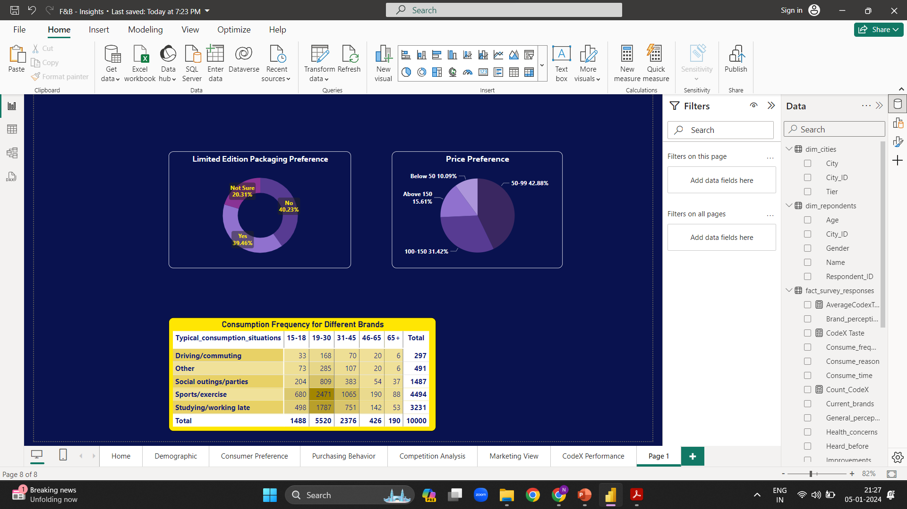
PURCHASE BEHAVIOUR
Where do respondents prefer to purchase energy drinks?
Supermarkets are the most common choice among consumers to buy energy drinks.
What are the typical consumption situations for energy drinks among respondents?
Sports / exercise, Studying/ working late Also, this data shows youth is consuming these drinks more.
What factors influence respondents' purchase decisions, such as price range and limited-edition packaging?
43% of the consumers buy a product if the price is between 50-99.
40% of the consumers do not expect a change in the packaging while 39% of consumers are open to trying the Limited-Edition Packaging.

